Slide 1
Parallel Computing
Ekkapot Charoenwanit
Software Systems Engineering
TGGS
KMUTNB

Slide 2
Lecture 8:
Shared-Memory Programming with OpenMP
Tasking

Slide 3
OpenMP: Tasking
OpenMP tasking provides a new parallel programming paradigm
called the work-oriented paradigm
based on the concept of a task pool/task queue
In this work-oriented paradigm, units of work (referred to as OpenMP tasks)
are generated or “pushed” into the task pool by threads
are retrieved or “pulled” off the task pool and executed by threads
Recall the producer-consumer pattern that we discussed in Lecture 3 !!!

Slide 4
OpenMP: Tasking
In classic OpenMP, threads are treated as a fundamental concept:
called the thread-centric paradigm
In the new work-oriented paradigm, we focus on units of work referred to as tasks.
We must now think how the code can be broken into units of work that can be executed in parallel.
We can think of a task as
code
data (data environment)
packaged up as an independent schedulable unit.

Slide 5
OpenMP: Tasking
Threads are assigned to perform the work of each task:
Tasks may be deferred.
Tasks may be immediately executed.
Tasks enable irregular computational problems to be parallelized in a natural way, e.g.,
Traverse a linked list while performing work on each node in parallel
Implement parallel recursive algorithms

Slide 6
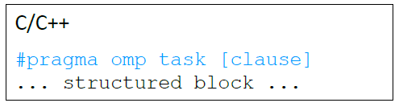
OpenMP: Tasks and Threads
A task has
code
a data environment
Each encountering thread packages a new instance of a task, e.g. code and data.
Tasks can be deferred ,i.e., they do not need to be immediately executed.
Some thread in the team executes the task at some time later.
The encountering thread that generate a task does not have to be the same thread that eventually executes the task.

Slide 7
OpenMP: Task Creation
Parallel regions create tasks:
One implicit task is created and assigned to each thread in the team.
Each thread that encounters a task construct:
Packages up code and data
Creates a new explicit task

Slide 8
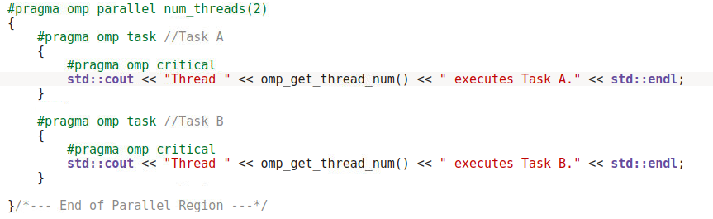

OpenMP: Task Creation

Slide 9
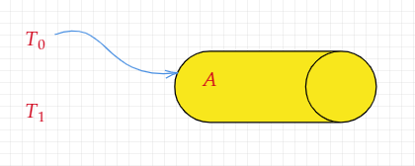
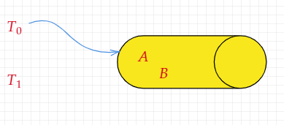
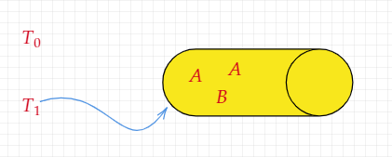
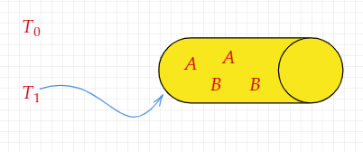
OpenMP: Task Creation

Slide 10
OpenMP: Task Creation
Each thread in the parallel region pushes two tasks to the task queue, i.e., four tasks are pushed to the task queue in total.
There is an implicit barrier at the end of the parallel region, which acts as a task synchronization construct.

Slide 11
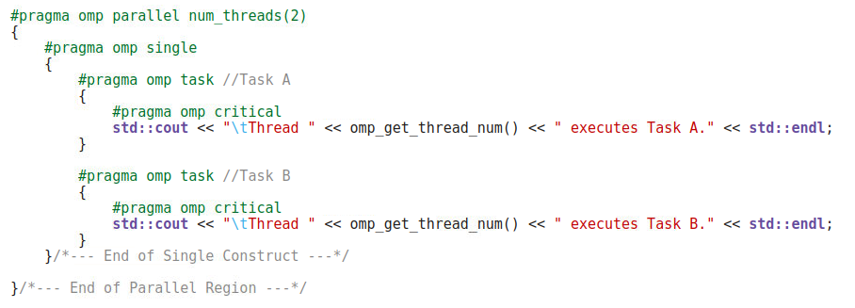

OpenMP: Task Creation

Slide 12
OpenMP: Task Creation
One of the two threads inside the parallel region is in charge of pushing tasks to the task queue.
There is an implicit barrier at the end of the single construct, which acts as a task synchronization construct.
The nowait clause can be used at the single construct to remove this implicit barrier.

Slide 13
OpenMP: Data Scoping
Data Scoping Rules: some rules from the parallel region still apply.
With no default clause,
static and global variables are shared.
automatic (local) variables are private.
Otherwise,
they are firstprivate
the shared attribute is lexically inherited.
Always use default(none) to force yourself to think carefully !!!

Slide 14
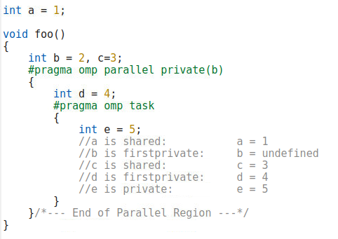
OpenMP: Data Scoping

Slide 15
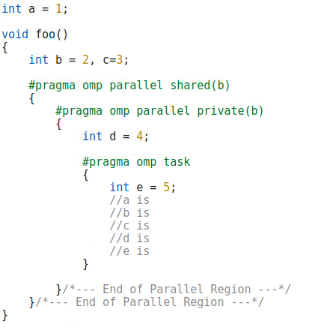

OpenMP: Data Scoping

Slide 16
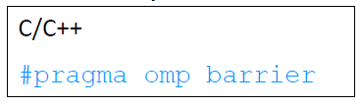
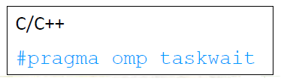
OpenMP: Task Synchronization
All tasks created by any thread of the current team are guaranteed to have completed at a barrier (implicit or explicit).
A task that encounters a task barrier is suspended until all child tasks complete.
This applies only to child tasks, not all descendant tasks.

Slide 17
Reference
[1] Ruud van der Pas, Eric Stotzer, and Christian Terboven. 2017. Using OpenMP -- The Next Step: Affinity, Accelerators, Tasking, and SIMD (1st. ed.). The MIT Press.

